Slide 1
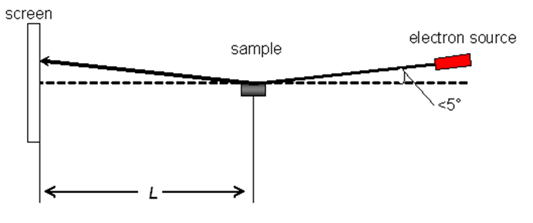
XI. Reflection high energy electron diffraction
Surface reconstruction studied by RHEED
--- used in MBE (molecular beam epitaxy)
Schematic of a
RHEED setup
The distance from sample to screen, L, and the energy of the electron beam must be known to derive the lattice spacing of the crystal.

Slide 2
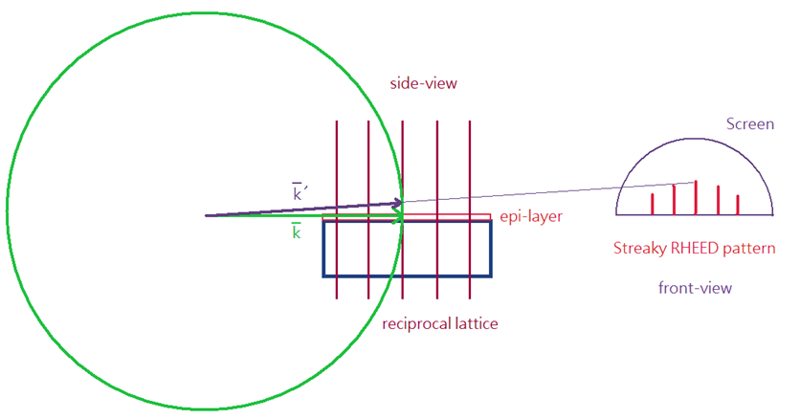
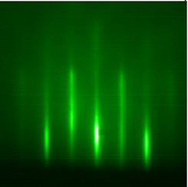
Streaky RHEED pattern

Slide 3
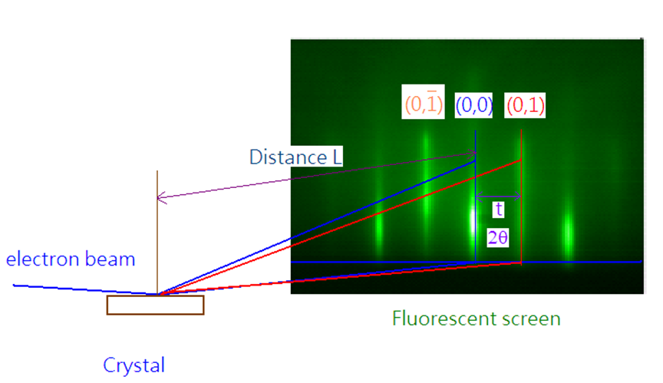
(1) Streaky pattern

Slide 4
Higher accuracy at longer L since t is longer.
(2) Sensitivity of RHEED
(2-1) Coherence zone
The electron beam can be treated an in-phase source only within a coherence zone.
The finite coherence zone is due to both finite convergence and finite energy spread of the electron beam.

Slide 5
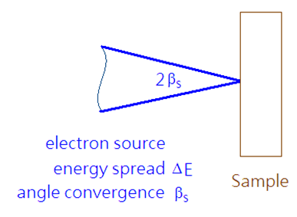
(a) Energy spread $∆E$ of incident electrons gives time incoherent

Slide 6
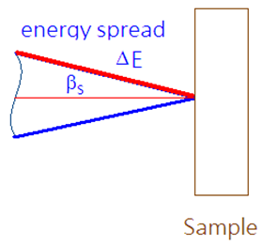
Resolved parallel to surface, for small β_{s}

Slide 7
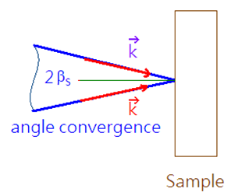
(b) Spread in arrival angle over 2β_{s} gives spatial incoherence,
(c) Combine uncertainties and define coherence zone diameter ΔX

Slide 8
-Typical RHEED, E = 100 keV, ΔE = 0.5 eV, and β_{s} = 10⁻⁵ rad → ΔX ≅ 200 nm!
-Typical LEED, E = 50-200 eV, ΔE = 0.5 eV, and β_{s} = 10⁻² rad → ΔX ≅ 5-10 nm!
RHEED＆LEED are sensitive to the order of surface atoms inside the area defined by coherence zone (area within the radius of ΔX)!

Slide 9
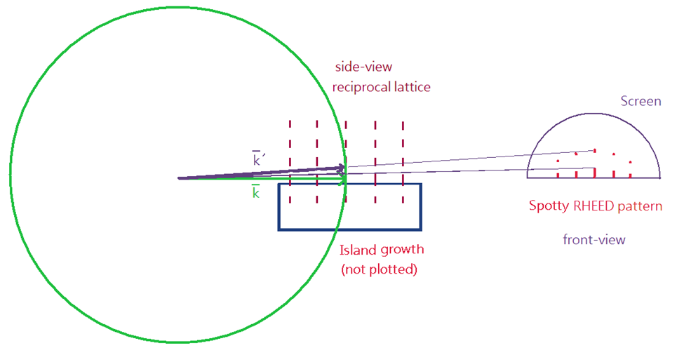
(2-2) Island growth

Slide 10
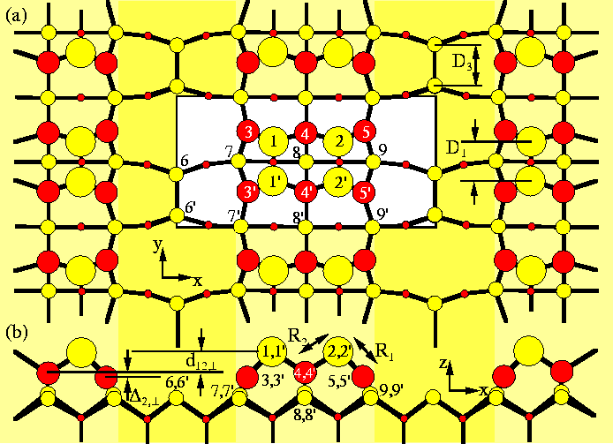
3. Surface reconstruction of GaAs(001)2x4
http://newton.ex.ac.uk/research/qsystems/people/jenkins/smg/gaas/gaas_001_beta2_2x4_top.gif

Slide 11
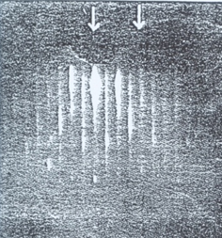
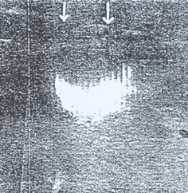
RHEED patterns of As-stabized GaAs(2x4) (30 KeV)
(a) Along
(b) Along

Slide 12
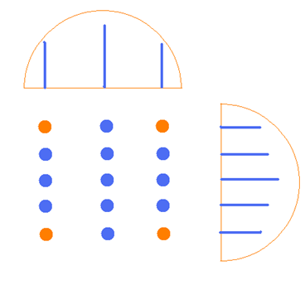
Explanation:
(1) Reciprocal lattice structure of GaAs(100)2x4
(2) RHEED patterns along two perpendicular directions

Slide 13
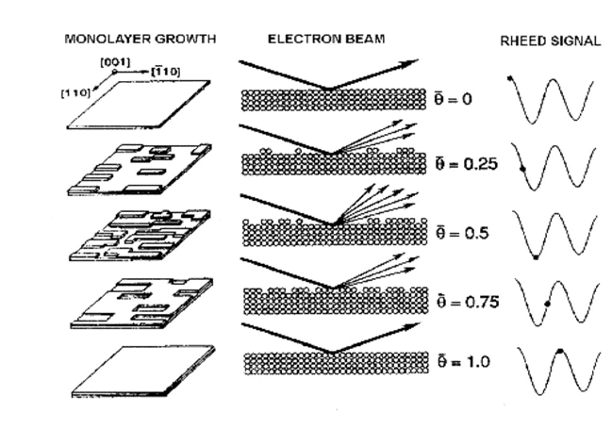
4. RHEED oscillation (adapted from Wiki)
With RHEED oscillation, the epitaxial growth of a film within a precision less than a monolayer can be achieved.
Mechanisms of RHEED intensity oscillations during growth of a monolayer.

Slide 14
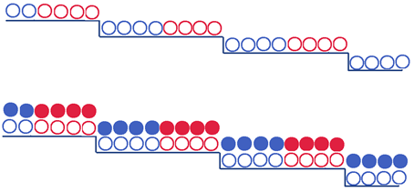
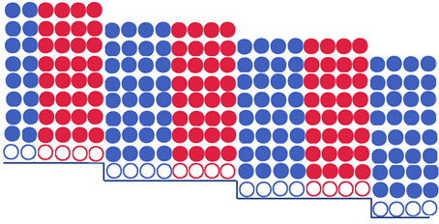
5. A/B tilted superlattice ( Petroff)

